Slide 1

Python Concepts and Programming

Slide 2
Python - Strengths
Free and Open source
Supported by large organizations
Great support communities on the internet
Great editors and environments
Easy syntax
General purpose language
Great packages in the area of Data Science
What is it not famous for?
Mobile development
Game development
Embedded software etc.

Slide 3
Python – Course Coverage
Basics
IDEs for working with Python and their installation
Control flow constructs
Collection data types
User defined functions, Lambda functions
Intermediate level
Modules and packages
OOPS programming
File handling
Exception handling
RDBMS data access
What is it not covered?
Concepts used infrequently
Niche areas requiring specific knowledge

Slide 4
Python – Course Coverage
Miscellaneous topics
Working with RegEx, JSON
List comprehension, Iterators
Other important Python modules – sys, os etc.
Data analysis
Introduction to Numpy
Pandas for data analysis
Seaborn for Visualization
Generative AI Intro
Tasks / Case studies
What is shared with you?
This ppt
Google Colab notebooks with code and concepts (same as in this ppt)
Links for Extended reading / practice

Slide 5
Python – Installation
1. Anaconda scientific distribution: - Anaconda 2022.05
https://www.anaconda.com/download
All important and essential python packages and 2 important IDEs are installed
Spyder - big projects
Jupyter notebook – interactive code with images, output etc
python <filename.py> (at Anaconda command prompt)
Anaconda prompt – to install more packages – conda install <package name>
2. Or use Google Colab using your google account - https://colab.research.google.com
Creating a virtual environment to isolate our code, package versions etc (folder and env names can be changed)
D:\>mkdir pvirtenv (any name)
D:\>cd pvirtenv
D:\pvirtenv>python -m venv pve (any name)
D:\pvirtenv>cd pve/scripts
D:\pvirtenv\pve\Scripts>activate
(pve) D:\pvirtenv\pve\Scripts>

Slide 6
Python – Intro
A Dutch programmer named Guido van Rossum implemented Python in 1991. He named it after the television show Monty Python's Flying Circus. Many Python examples and tutorials include jokes from the show.
Python is a freely available general purpose language. Its applications are vast and varied
Python is easy to learn and use. It is developer-friendly and high level programming language.
Python is an interpreted language i.e. interpreter executes the code line by line at a time. This makes debugging easy and thus suitable for beginners.
Python is a type inferred language and smart enough to set appropriate variable types without our declaration.
We can apply multiple assignments in two ways either by assigning a single value to multiple variables or assigning multiple values to multiple variables.
x=y=z=50
a,b,c=5,10,15

Slide 7
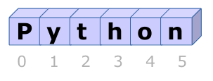
Python – Intro
Basic data types in Python:
Int
Float - Decimal
Boolean – True / False
String - Text
String in python are surrounded by either single quotation marks, or double quotation marks
String is an array of characters accessed using indices
Implicit Type conversion – where Python is clear on what it should do
Type casting – converting one data type into another explicitly
int()
float()
str()

Slide 8
Python – Intro
String functions:
strip() – remove whitespaces
len() – no of characters in string
lower(), upper()
replace() – replace one string with another
split() – split using a character
input() – to accept user input from keyboard
Operators
Arithmetic operators
Assignment operators
Comparison operators
Logical operators
Identity operators
Membership operators
View and try here and in the code shared - https://www.w3schools.com/python/python_operators.asp

Slide 9
Python – Intro
If else, nested if else
If …elif..else construct – to check multiple conditions
Shorthand if – single line syntax
Shorthand if else – single line syntax
while loop – to do something till some condition is met
for loop – used with iterable objects. Easier to use than while loop
break – to come out of a loop

Slide 10
Python – Collection data types
List is a collection which is ordered and changeable. Allows duplicate members.
Tuple is a collection which is ordered and unchangeable. Allows duplicate members.
Set is a collection which is unordered and unindexed. No duplicate members.
Dictionary is a collection which is unordered, changeable and indexed. No duplicate members.
Tuples to be used when we need to ensure a collection is not updated in code
Sets to be used if we have use cases requiring set operations like union, intersection etc.
Use a dictionary if the purpose is to store key value pairs like configuration settings.

Slide 11
Python – Lists
List is a collection which is ordered and changeable. Allows duplicate members.
They are similar to arrays in other languages. Multiple data type members can be used
Lists are created with square brackets.
You access or update the list items by referring to the index number
You can loop through the list items by using a for loop
in keyword
len()
append() - Adds an element at the end of the list
insert() - Adds an element at the specified position
remove() - Removes the item with the specified value

Slide 12
Python – Lists
pop() - removes the specified index, (or the last item if index is not specified)
del – can be used for a member or the list itself
clear() - Removes all the elements from the list
count() - Returns the number of elements with the specified value
extend() - Add the elements of a list (or any iterable), to the end of the current list
index() - Returns the index of the first element with the specified value
reverse()
sort()

Slide 13
Python – Tuples
Tuple is a collection which is ordered and unchangeable. Allows duplicate members.
Tuples are written with round brackets
You can access tuple items by referring to the index number, inside square brackets
You can loop through the tuple items by using a for loop
in keyword
len()
del – to delete the tuple itself
count() - Returns the number of elements with the specified value
index() - Returns the index of the first element with the specified value

Slide 14
Python – Sets
Set is a collection which is unordered and unindexed. No duplicate members.
Sets are written with curly brackets
You can loop through the Set items by using a for loop
Once a set is created, you cannot change its items, but you can add new items.
in keyword
len()
add()
update() – to add multiple items
remove()
del – to delete the set itself
clear() - Removes all the elements from the set

Slide 15
Python – Sets
difference() - Returns a set containing the difference between two or more sets
intersection() - Returns a set, that is the intersection of two other sets
isdisjoint() - Returns True if the intersection is null
issubset() - Returns whether another set contains this set or not
issuperset() - Returns whether this set contains another set or not
union() - Return a set containing the union of sets

Slide 16
Python – Dictionaries
Dictionary is a collection which is unordered, changeable and indexed. No duplicate members.
Dictionaries are written with curly brackets, and they have keys and values
You can access or update the items of a dictionary by referring to its key name, inside square brackets
You can loop through the list items by using a for loop.
Adding an item to the dictionary is done by using a new index key and assigning a value to it
len()
pop()
clear()
items() - Returns a list containing the a tuple for each key value pair
keys() - Returns a list containing the dictionary's keys
values() - Returns a list of all the values in the dictionary

Slide 17
Python – User defined functions
Python allows us to divide a large program into the basic building blocks known as function. A function can be called multiple times to provide reusability and modularity
Types of arguments
Required arguments
Keyword arguments
Default arguments
Variable-length arguments
In python, the variables are defined with the two types of scopes.
Global variables
Local variables
The variable defined outside any function is known to have a global scope whereas the variable defined inside a function is known to have a local scope.

Slide 18
Python – Modules
Find out the exact module you need from internet
See if it is already installed on your laptop. By typing import
If it is not installed, install it by using the command mentioned in Anaconda at Anaconda prompt
Now we can use the module by using the import statement. Alias is optional
You can choose to import only parts from a module, by using the import from statement
To create a module just save the code you want in a file with the file extension .py
You can access the module from the same directory or from its parent folders using directory name
Packages allow to have a hierarchical structuring of the module. Create a folder , place modules in it and access with folder. Notation. Packages help to avoid collisions between module names.
You can use modules from anywhere in laptop by using (sys.path.append(r’module path’))
Anaconda navigator helps in administration of modules, environments etc.

Slide 19
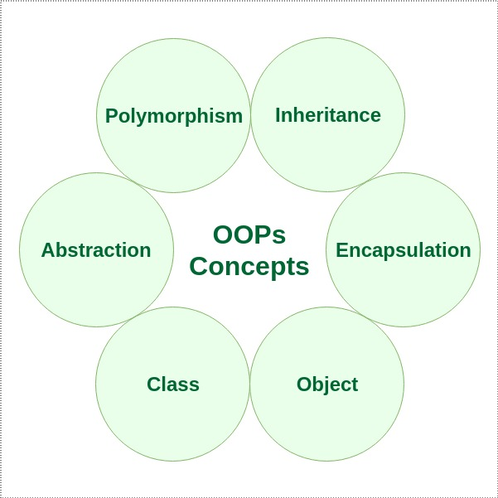
Python – Procedural vs OOPS programming
Issues with Procedural programming
Difficulty in managing changes and in extending code
Difficulty in isolating changes
Code reuse limited to reusing functions
Difficulty in modeling real world behavior as only functions are there
OOPS to the rescue
Map real-world objects in software
Every object should have state and behavior
State is represented by data members or variables. Behavior is represented by functions

Slide 20
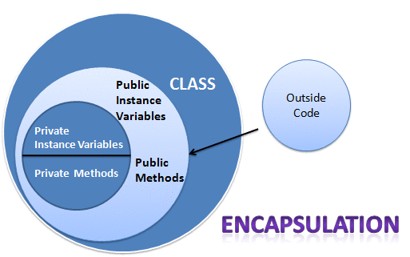
Python – OOPS programming
Encapsulation
Encapsulation is achieved when each object keeps its state private, inside a class. Other objects don’t have direct access to this state. Instead, they can only call a list of public functions — called methods.
Data hiding is to reduce the binding between different classes. The more objects know each other, the more they will have to change when one of them changes. It is like having a call center for an organization instead of exposing all employees in the org.
Abstraction
Applying abstraction means that each object should only expose a high-level mechanism for using it.
Internal implementation details should be hidden
You interact with your phone by using only a few buttons. What’s going on under the hood?
You don’t have to know — implementation details are hidden. You only need to know a short set of actions. Implementation changes — for example, a software update — rarely affect the abstraction you use.

Slide 21
Python – OOPS programming
A class is a virtual entity and can be seen as a blueprint of an object.
On the other hand, the object is the instance of a class. The process of creating an object can be called as instantiation.
A constructor is a special type of method (function) which is used to initialize the instance members of the class.
Class variables are variables that are being shared with all instances (objects) which were created using that particular class. So when accessed a class variable from any instance, the value will be the same.
Instance variables, on the other hand, are variables which all instances keep for themselves (i.e a particular object owns its instance variables). So typically values of instance variables differ from instance to instance.
Class variables in python are defined just after the class definition and outside of any methods
Unlike class variables, instance variables should be defined within methods using “self”
Just as there are instance and class variables, there are instance and class methods

Slide 22
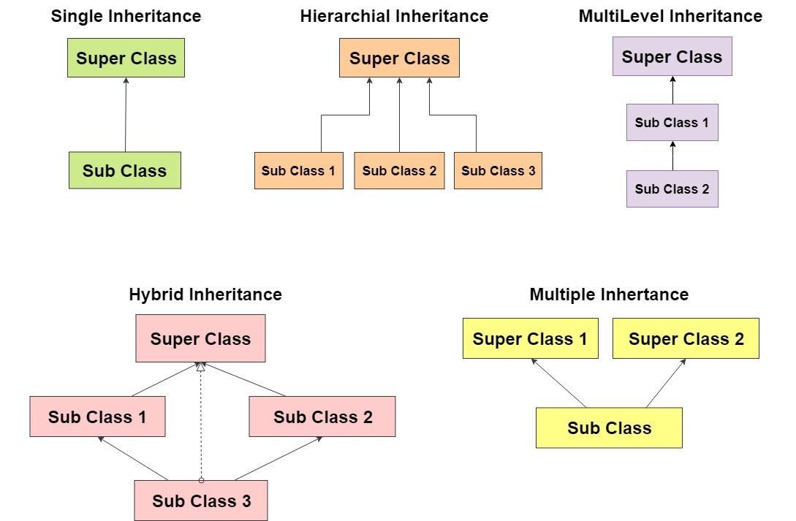
Python – OOPS programming
Inheritance
Objects are often very similar. They share common logic. But they’re not entirely the same.
So how do we reuse the common logic and extract the unique logic into a separate class? One way to achieve this is inheritance.
It means that you create a (child) class by deriving from another (parent) class. This way, we form a hierarchy.
The child class reuses all fields and methods of the parent class (common part) and can implement its own (unique part).

Slide 23
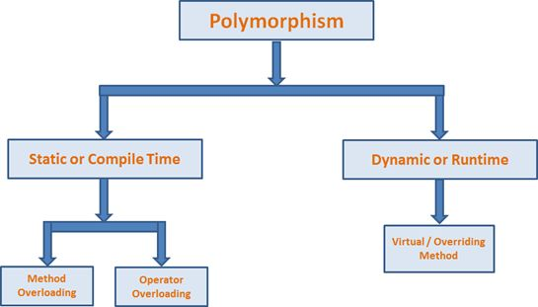
Python – OOPS programming
Polymorphism
The ability to appear in many forms.
The right class / object to be used is determined at Runtime based on what actual object is instantiated.
Lot of Switching logic can be eliminated by using runtime polymorphism
Also, it is the ability to redefine methods for derived classes - Overriding
Polymorphism allows for flexibility and loose coupling so that code can be extended and easily maintained over time.

Slide 24
Python – Text File access
The key function for working with files in Python is the open() function. It open() function takes two parameters; filename, and mode.
file.close()
file.read([size])
file.readline([size])
file.write()
file.seek(offset, relative position)
There are four different methods (modes) for opening a file:
"r" - Read - Default value. Opens a file for reading, error if the file does not exist
"a" - Append - Opens a file for appending, creates the file if it does not exist
"w" - Write - Opens a file for writing, creates the file if it does not exist
"x" - Create - Creates the specified file, returns an error if the file exists

Slide 25
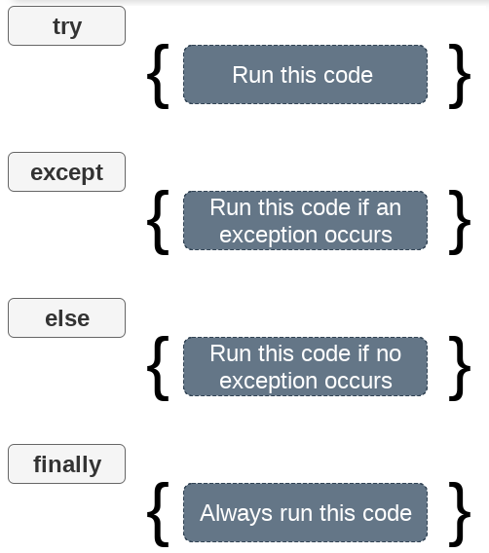
Python – Exception handling
An exception can be defined as an abnormal condition in a program resulting in the disruption in the flow of the program.
Whenever an exception occurs, the program halts the execution, and thus further code is not executed.
Python provides us with the way to handle Exceptions so that:
Cleanup tasks can be performed like closing connections etc.
Show user friendly messages
Just ignore the exception
List of exceptions
https://docs.python.org/3/library/exceptions.html

Slide 26
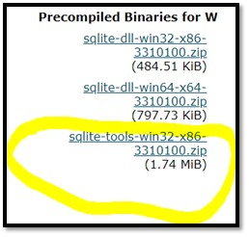
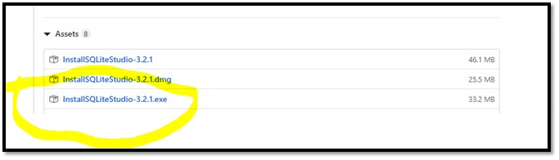
Python – Data access
SQLite does not require a separate server process or system to operate (serverless).
SQLite comes with zero-configuration, which means no setup or administration needed.
A complete SQLite database is stored in a single cross-platform disk file.
SQLite is very small and light weight, less than 400KiB fully configured or less than 250KiB with optional features omitted.
Install SQLite and then SQLite studio
https://www.sqlite.org/download.html
https://github.com/pawelsalawa/sqlitestudio/releases/tag/3.2.1

Slide 27
Python – Data access
import sqlite3
sqlite3.connect(database)
This API opens a connection to the SQLite database file. You can use ":memory:" to open a database connection to a database that resides in RAM instead of on disk. If database is opened successfully, it returns a connection object.
connection.cursor()
This routine creates a cursor which will be used throughout of your database programming with Python.
cursor.execute(sql)
This routine executes an SQL statement. The SQL statement may be parameterized (i. e. placeholders instead of SQL literals). The sqlite3 module supports two kinds of placeholders: question marks and named placeholders (named style).
connection.commit()
connection.rollback()
connection.close()

Slide 28
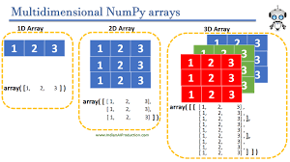
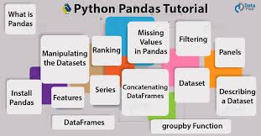

Python – Modules for Data Analysis

Slide 29
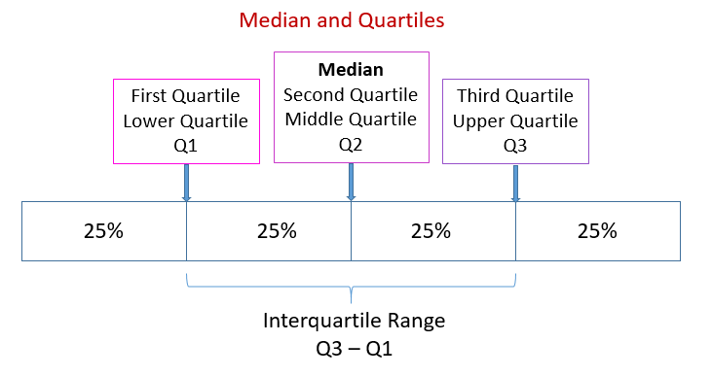
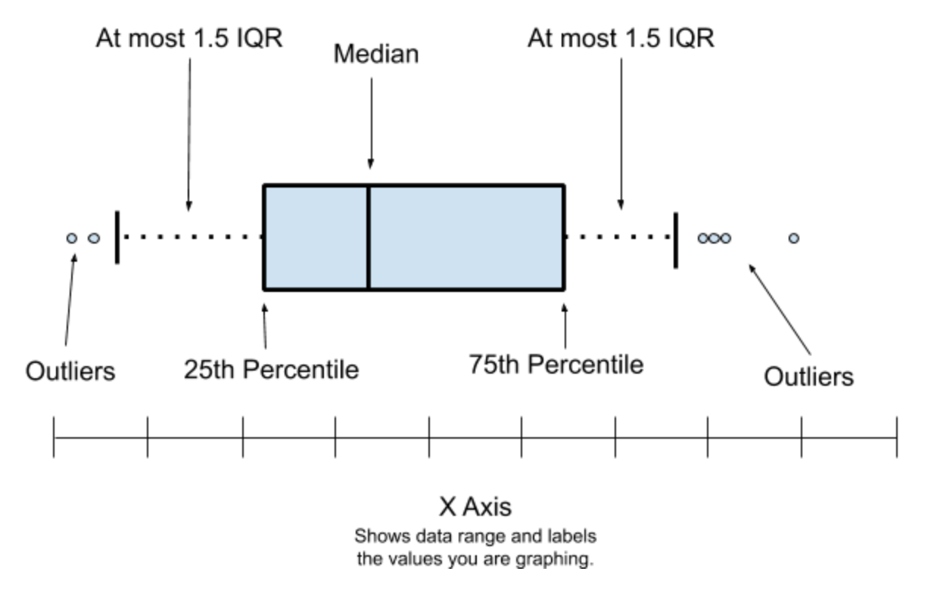
Python – Elementary Statistics
Measures of central tendency describe the centre point of a data set with a single value.
Mean is calculated using values whereas Median and quartiles are positional
Measures of dispersion describe how far individual data values have strayed from the centre point .
The variance is a measure of dispersion that describes the relative distance between the data points in the set and the mean of the data set. Standard deviation is the square root of a variance.

Slide 30
Python – Tasks
Python exercises
Next slide
Python interview questions:
https://intellipaat.com/blog/interview-question/python-interview-questions/
Tasks – Details in next slides
Calculator - easy level
Bank case study - medium level
Projects related Tasks
pandas case study with project data following examples from titanic and other datasets - Prepare a list of interesting questions and answer them
seaborn case study with project data following examples from built in datasets - Prepare a list of interesting questions and answer them

Slide 31
Python – Exercises
Explore different options available in Spyder, Jupyter notebooks and Colab
Go through the guidance in Colab home page
Create a file in Colab and open it in Jupyter and Spyder
Find the Second Largest Number in a collection of values
Find the no of times a sub-string is repeated in a string
Swap the case of characters in a string
Implement Selection sort for a given collection of numbers
Add 2 numerical matrices without using numpy

Slide 32
Python – Calculator operations
Use OOPS to create below methods for the Calculator class
Calc.EnterNumber(int)
Calc.Add()
Calc.Subtract()
Calc.Multiply()
Calc.Divide()
Calc.CancelAll()
Calc.ShowResult() (similar to = operator)
#############Sample test code
Calc= Calculator()
Calc.EnterNumber(3) # after every EnterNumber call, some operation should be called
Calc.Add()
Calc.EnterNumber(5)
Calc.Subtract()
Calc.EnterNumber(2)
# Calc.CancelAll()
Calc.ShowResult() – should return either a number or None
### return value : 6 (without cancelall)
### return value : None

Slide 33
Python – Bank operations
Use OOPS, Data access and exception handling to create below methods for the Bank class
Use this schema for BankTran in DB – CustId, Name, Balance
Persist the data in SQLite DB – Bank, Table name - BankTran
## Sample test code
bk=Bank()
bk.CreateAccount(CustId, Name, Balance)
bk.WithdrawAmount(CustId, Amt)
bk.DepositAmount(CustId, Amt)
bk.RemoveAccount(CustId)
bk.GetBalance(CustId) # return the balance as int
We should be able to call these methods in any order and they have to work appropriately. Exception handling is a must.

Slide 34
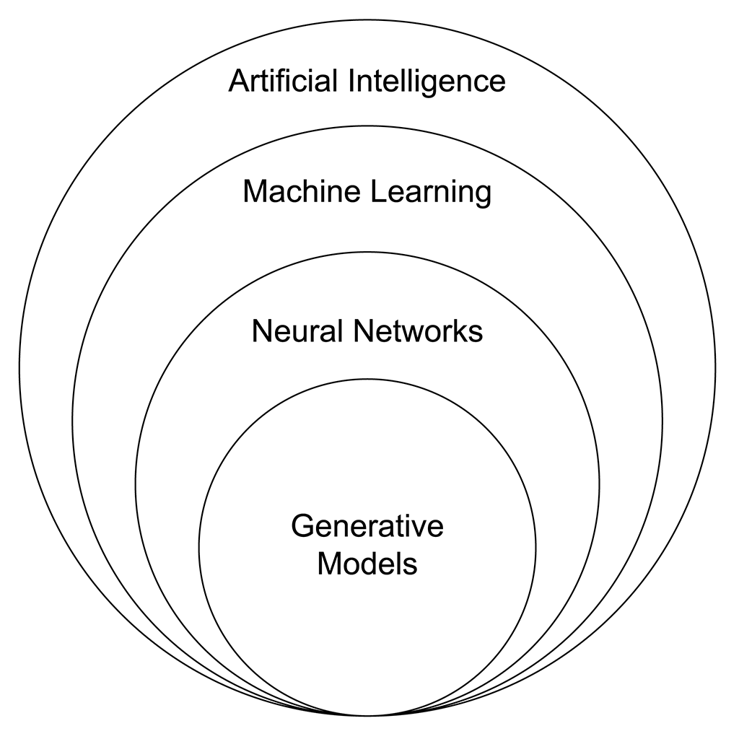
Introduction to Generative AI
Traditional AI ML: Primarily makes predictions using Classification and Regression based on patterns in training data
Generative AI: Generates new data using patterns learned from training data. Used for text generation, image generation, audio generation etc.
Traditional AI ML: Can work with less amount of data as well
Generative AI: Needs a large amount of data to learn and generate new content
Traditional AI ML: Training may or may not be computationally expensive based on data used
Generative AI: Training generative AI models is computationally intensive
Traditional AI ML: Predicts based only on existing data
Generative AI: Generates new content

Slide 35
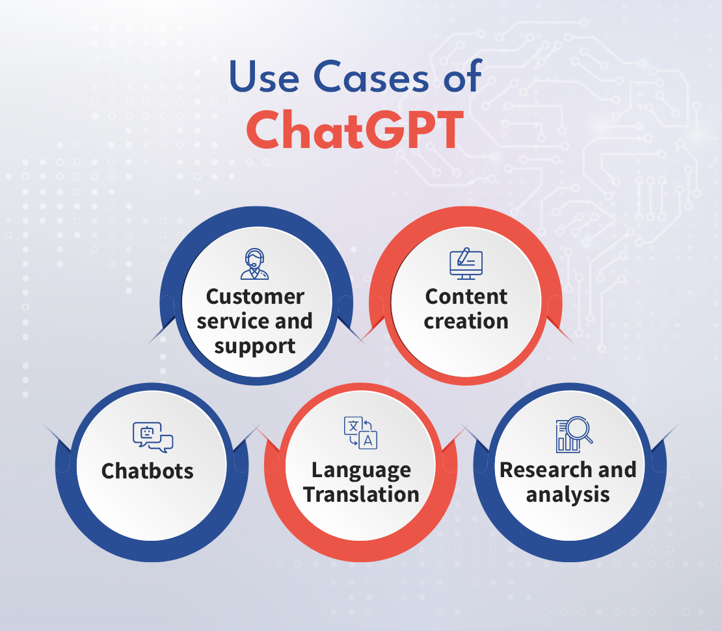
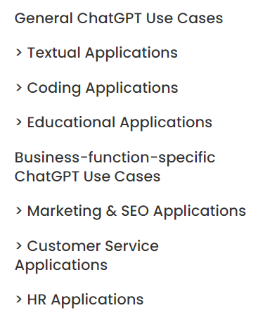
ChatGPT use cases
https://research.aimultiple.com/chatgpt-use-cases/

Slide 36
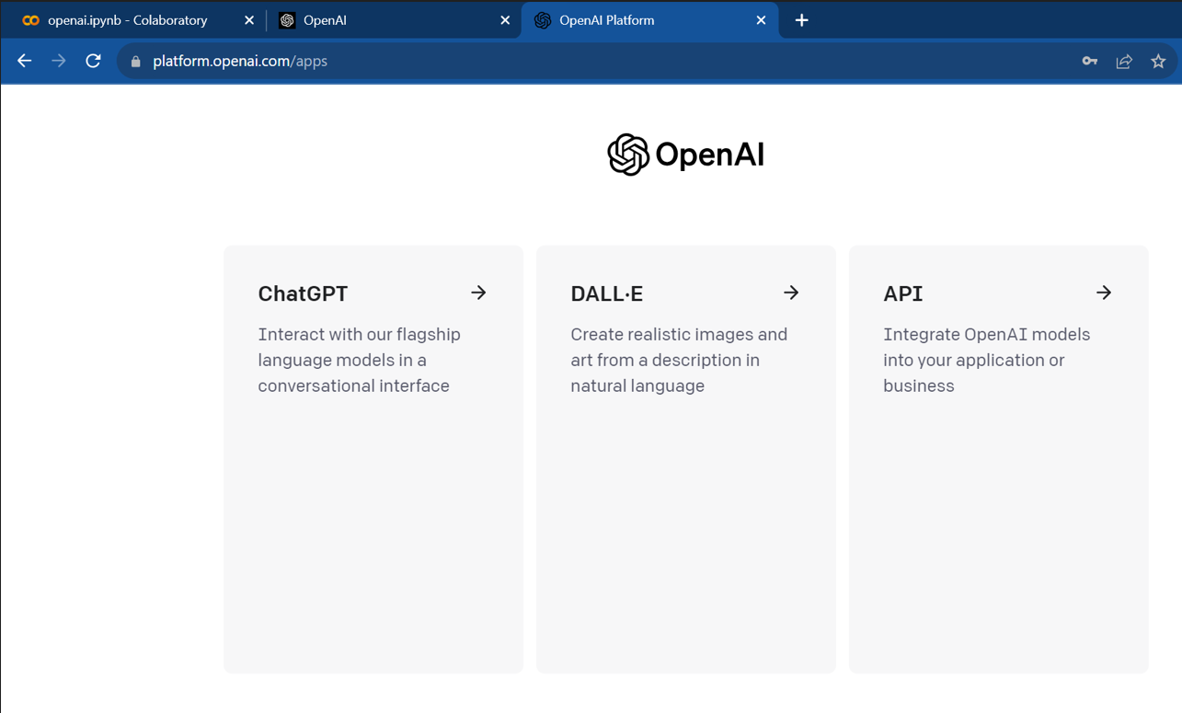
Using ChatGPT
https://openai.com/
Sign in using validation steps
You can try from outside Cognizant network like VMs / personal laptop etc.

Slide 37
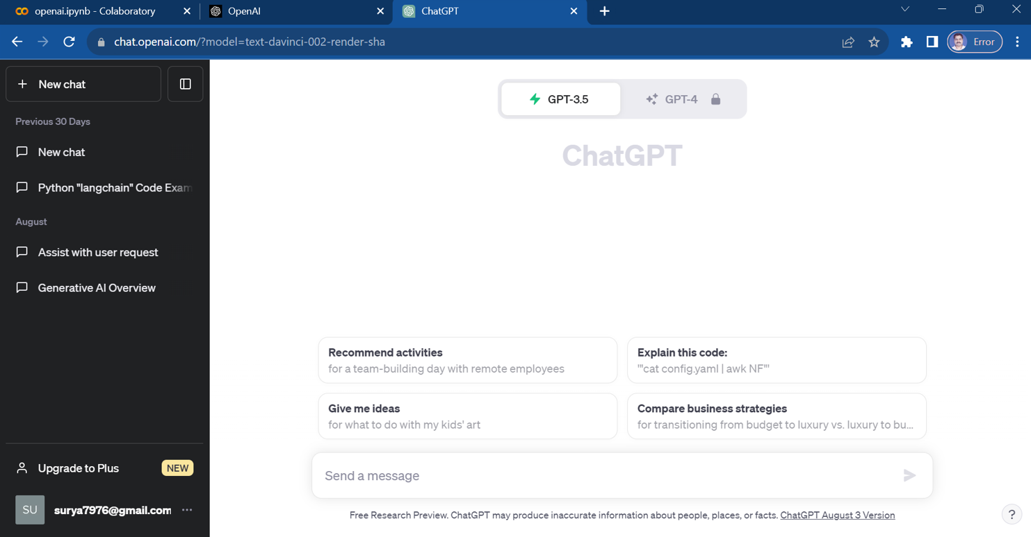
Using ChatGPT
You can directly work with it in the Web UI that is provided

Slide 38
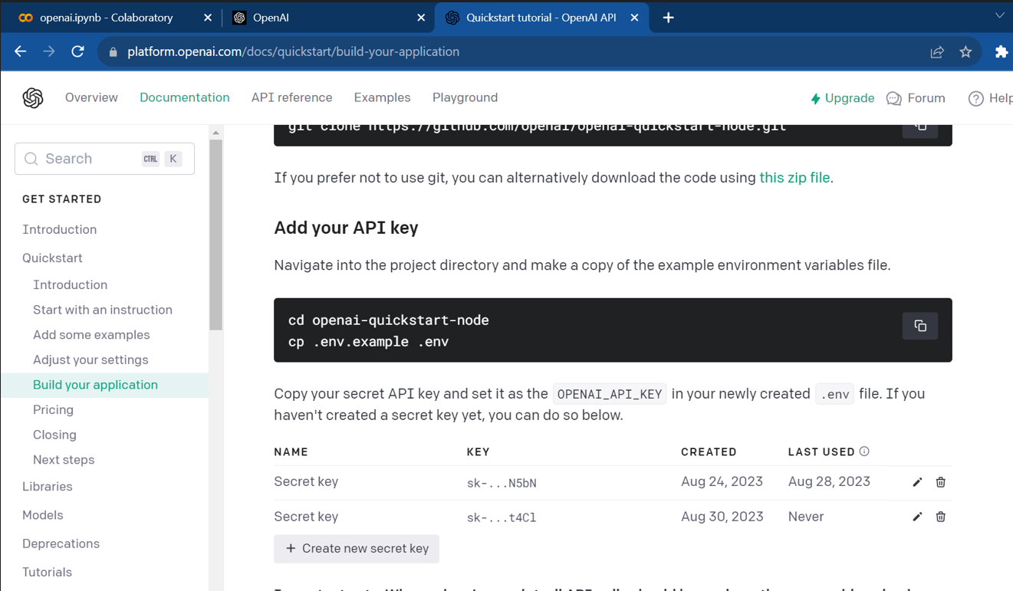
Using ChatGPT
You can use its power from various applications etc. by using the OpenAI API key it provides
Use the url
https://platform.openai.com/account/api-keys

Slide 39
Generative AI - Different ways of using it
At the most basic level anyone can log into ChatGPT, Bard etc. and get answers to their questions - Like the way students and others are using it
Prompt engineering helps us get the right and precise response from Generative AI tools
Programmers can make their work happen faster and in a better way by by using code generation tools like Github Copilot, Amazon Code Whisperer etc.
Experts in the Data Science field use Generative AI to extend the capabilities of the AI / ML solutions by customizing the Generative AI capabilities to their use cases
The Use cases are specifc to the domain. So domain knowledge need to combined with the Generative AI tools and technologies

Slide 40
Thank You

